Slide 1



Sessions &
Client Milestones

Slide 2
SOP Review:
Sessions

Slide 3
Consulting Sessions
Substantive Consulting
Substantive consulting is direct (contact) and non-direct (prep) consultation that has sufficient market value to be constituted as a billable service in a private sector engagement. Substantive consulting is one-on-one consulting and addresses a specific need of that individual business. “Would a private sector business management consultant charge a client for work?”.
It is not:
● contact with a client or potential client for the sole purpose of scheduling an appointment;
● providing the client or potential client with non-business information, such as directions, office hours, description of services, referral to another resource;
● "checking in" with a client;
● collecting or producing information for network purposes (e.g. economic impact, success stories), or
● mailing or emailing of general information or materials (e.g. newsletters, workshop promotions, etc.)
Logged as “Session”
Logged as “Non-Consulting Activity”
LAUNCH. GROW. THRIVE

Slide 4
Special Circumstances: Consulting
Group Consulting
Exceptions are made for programs designed to provide individual, specific, and substantial recommendations and action items to attendees (ex: CEO Xchange). In these instances, consultants are allowed to prorate prep and contract hours for each participating member.
This is not general training.
Co-Consulting
Consultants are encouraged to co-consult (in the same region or cross-regionally) in order to best serve the needs of a client. Each consultant may track their prep time individually, however, contact hours should not be double-counted. For example, if a client meets with two consultants for one hour either of the following may occur: a) one consultant may count the entire hour or b) each consultant may count .5 hour.
LAUNCH. GROW. THRIVE

Slide 5
Missed Consulting Sessions
A missed session should be added if:
● A client contacts the consultant to cancel or reschedule a session LESS than 24 hours of the meeting time, or
● If a client does not show up for a meeting
A missed session should not be added if a client contacts the consultant to reschedule a meeting with more than 24 hours notice of the meeting time.
Consultants have the right to discontinue services to a client after the third no-show or cancellation without a minimum of 24 hours advance notice.
LAUNCH. GROW. THRIVE

Slide 6
Details Logged on Sessions
Questions Answered | Fields
Who? | “Participant Details”: Contact, Business, Regional Consultant
Where? | Contact Type, Session Site
When? | Date & Time (Session Status), Prep & Contact Time, Travel Time
How? | Contact Type, Language(s) Used
What? | Program, Sub-Program Area of Counseling, Area of Counseling Sub-Type Session Notes AI Consulting Delivered Checkbox Client Milestone
LAUNCH. GROW. THRIVE

Slide 7
SOP Review:
Reportable Impact

Slide 8
Details Logged on Reportable Impact
Questions Answered | Fields
Who? | “Milestone Details”: Contact, Business, Regional Consultant
What Type? | Capital: Loans (w/ or w/o SBA details); Other Investment Owner Investment; STEP Services (ending 9/26)
 | Government Contracts: DOD or Federal Prime & Sub State or Local Prime & Sub - both amount ($) and number (#)
 | Jobs & Revenue: Jobs Created; Jobs Retained (Saved); Revenue (Sales) Increase
 | Started Business - Business Start Date & Check Box
 | SBA Certifications (if SBDC consultant)
LAUNCH. GROW. THRIVE

Slide 9
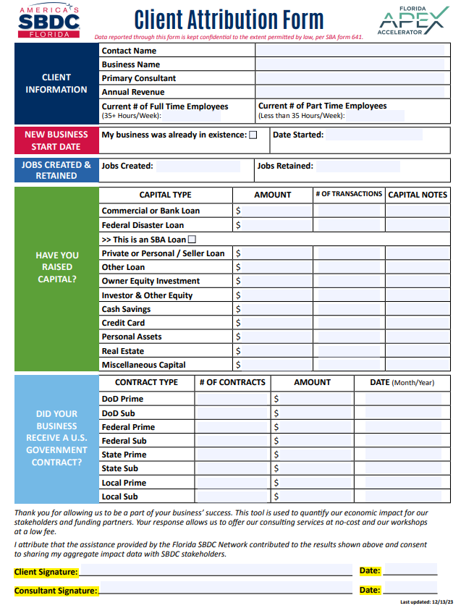
Reportable Impact Requirements
Attribution Types
Email or Letter – To meet the standard, the customer email or letter must meet both the Verification Test and Attribution Test:
Verification Test –
The email or letter must specifically identify the impact or outcome that occurred (e.g. started new business, hired three new employees, received $1M loan), and
Attribution Test –
The customer must specifically state in the email that the outcome occurred as a result of the SBDC services received.
Impact that is verbalized or otherwise discovered through other verification (e.g. news stories, third-party sources) alone does not constitute a reportable impact due to the lack of attribution. However, the Center may use such information to follow-up with the client to discover if the impact was attributed to the services received.
Other Forms of Attribution:
Customer Survey
Client Impact Attribution Form –
The authorized form may be found on Sharepoint site.
LAUNCH. GROW. THRIVE

Slide 10
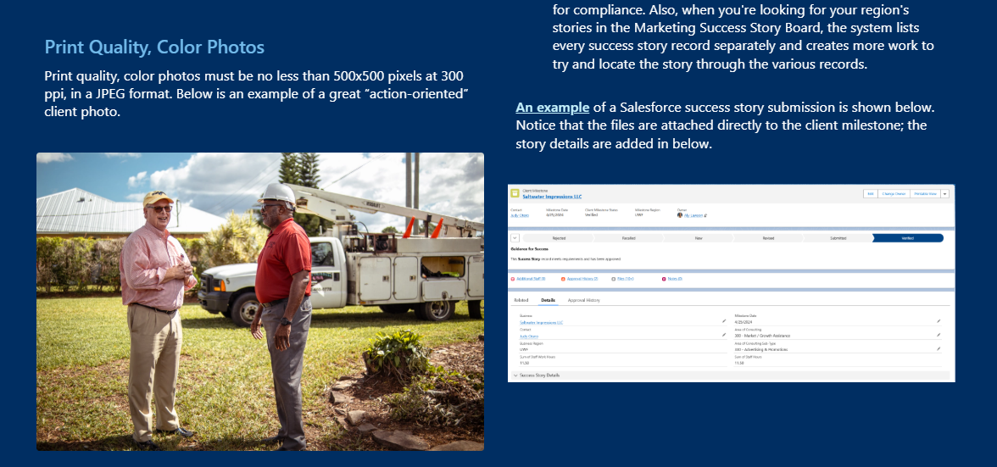
Success Story Milestone Requirements
A "Full" Client Success Story Includes
1. Professionally-written Client Story
2. Client Satisfaction Quote
3. Print Quality, Color Photo
4. Signed Client Release
LAUNCH. GROW. THRIVE

Slide 11
Salesforce Training
New Session Entry Process & Workflow Optimization
Version 1.1 | May 2026 | Florida SBDC Network

Slide 12


Mission & Objectives
Enhancing User Experience
Existing processes only validated data after clicking "Save," leading to user frustration. The new interface addresses these bottlenecks by ensuring data integrity from the start.
Strategic Goals:
Eliminate redundant manual corrections for SBA.
Provide real-time error checking.
Streamline Session and Milestone recording.

Slide 13






Key System Enhancements
Real-Time Validation
Auto-Association
Multi-File Upload
Errors are flagged immediately before records are committed to the database, preventing lost work.
All lookup fields are automatically linked between Session, Milestone, Contact, and Account records.
Users can add multiple files directly within the entry interface, reducing page loads and clicks.

Slide 14
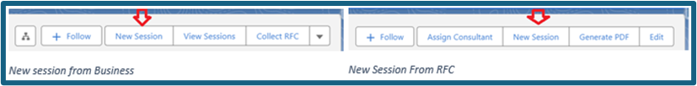
Accessing New Session Entry
Unified Entry Points
To ensure data consistency, sessions can only be generated from two specific locations:
Business Record: Primary method for recurring sessions.
ERFC Record: Restricted to one session per request.
Note: List views, cloning, and “New” session buttons on contact records will be retired 1 week after go live.

Slide 15



Defaults in Session Data Entry
Contact Field
Regional Consultant
Language Used
Pre-fills with the Primary Contact. Prevents selection errors by filtering the dropdown to related contacts only.
Defaults to the logged-in user. Can be changed by clearing the field to search for another active consultant.
Defaults to English. Supports multiple selections for Spanish, French, Creole, and others.

Slide 16
Synchronized Business Information
Fields in this section sync directly with the Business record. Updates here are written to the master record once the session is Completed.
Data Category | Required Fields | Impact Logic
Employment | Full-Time & Part-Time Employees | FTE sum must be ≥ 1 for "In Business"
Financials | Annual Revenue & Annual Profits/Loss | Pre-populated from Business record
Int’l Trade | Exporting Status & Destination Countries | Triggers additional screens if destination changes

Slide 17
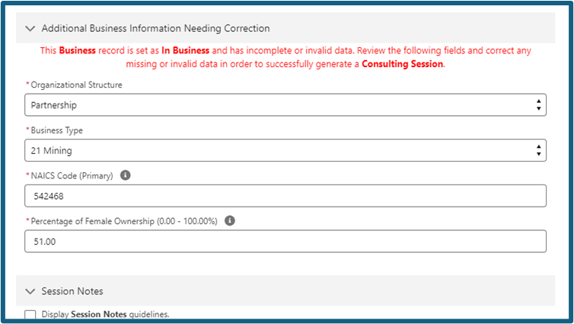
Data Integrity
Mandatory Validations
If a business is marked as "In Business" but lacks valid data, the system forces correction in these fields:
Organizational Structure
Business Type
Percentage of Female Ownership
NAICS Code (Primary): Must match the selected Business Type. (See Photo)
Note: Only Sessions with a status of “COMPLETED” update the business record.
This prevents "orphaned" or invalid industry data in SBA reporting.

Slide 18
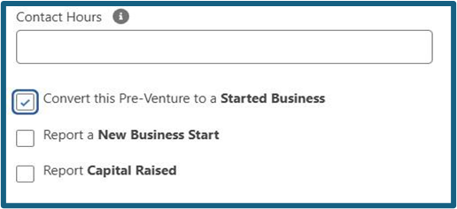
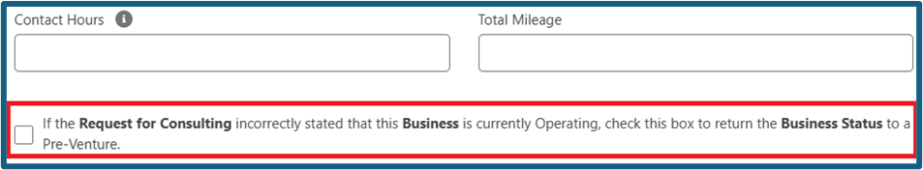
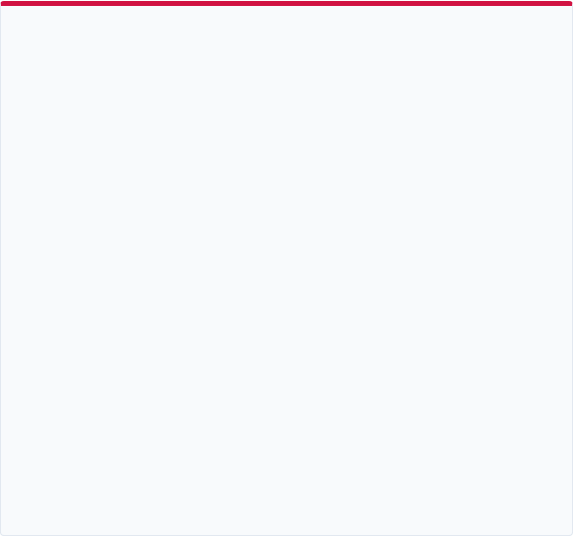
Correcting Business Status
Not Really In Business
Actually In Business
If a client states they are operating on the ERFC but are actually not, consultants can use the "In-Business to Pre-Venture" override.
If a client states they are not yet operating on the ERFC but actually are, consultants can use the "Convert this Pre-Venture to a Started Business.”
This clears employment and sales data and updates the Business Status to "Not Yet in Business".
This is for correction or when a client is not willing to sign an impact form.
Additional fields will be required and must have values, even if a zero (for things like revenue).

Slide 19
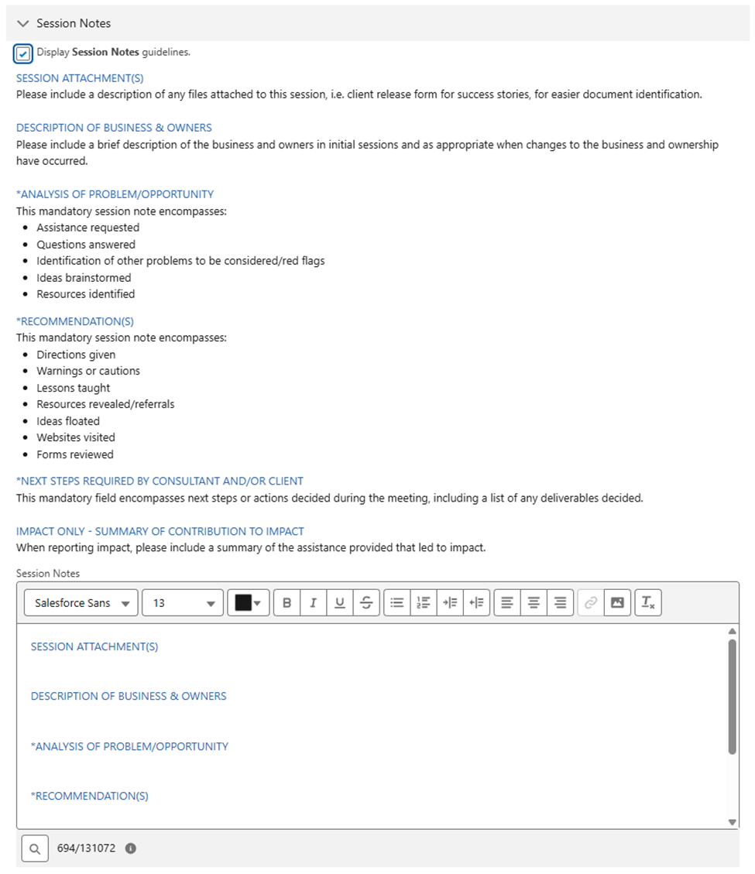
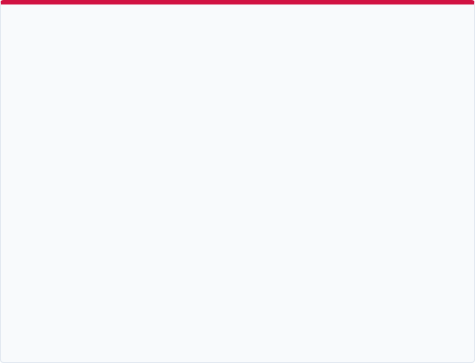

Session Outlines
Standardized Session Notes
Check “Display Session Notes guidelines.” The rich text box is pre-filled with the mandatory template including:
Analysis of Problem/Opportunity
Consultant Recommendations
Next Steps for Client/Consultant
File Uploads: Attach Session-specific files here - NOT attribution forms
Artificial Intelligence
A new checkbox tracks if AI application was discussed.
Any consulting session where Artificial Intelligence is discussed in a substantive manner/length of time or as a means to improve a process or outcome, solve a problem, or gain a competitive edge.

Slide 20
Converting Pre-Ventures
Session Complete
Data Entry
Milestone Claim
Impact Form
Review summary and generate the Impact Record. Choose to attach attribution and submit.
Enter Open Date, Key Business Details, Employees (FTE ≥ 1), and Financials.
Identify status change and select "Convert to Started Business".
Select "Report New Business Start" or "Capital Raised".

Slide 21
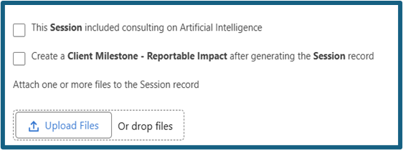
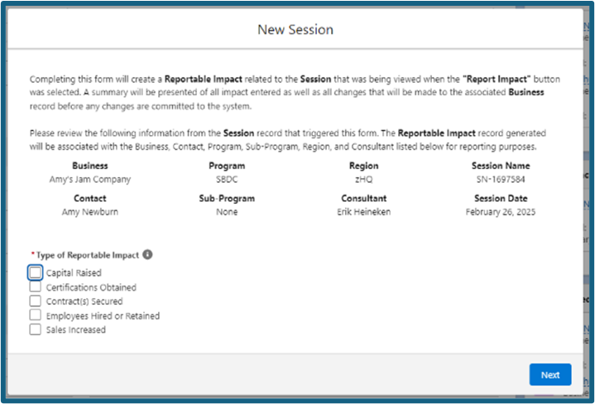

Reporting SBDC Economic Impact for In-Business Clients
Approval Workflow: If a PDF attribution is attached, milestones can be sent directly to the regional approval queue from the entry interface. Can also choose to attach, but not submit, or generate the milestone and attach/submit later.

Slide 22
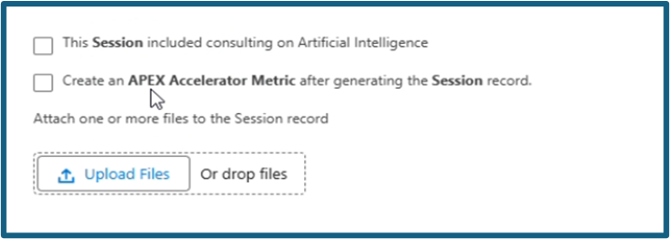
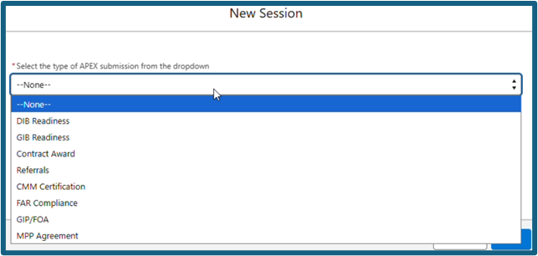
Reporting APEX Economic Impact for In-Business Clients
Note: Contract Awards generate a client milestone as well (standard procedure now).
Approval Workflow: If a PDF attribution is attached, milestones can be sent directly to the regional approval queue from the entry interface. Can also choose to attach, but not submit, or generate the milestone and attach/submit later.

Slide 23


Questions?
Salesforce Administration & Support Team
erik.heineken@floridasbdc.org
james.gray@floridasbdc.org

